Slide 1
CSC120 Computing Fundamentals I Fall 2021 Instructor: Curt Knowles

Slide 2
What is a function?
A unit of code that performs a task.
Called subroutines, methods, procedures, etc. in other languages, functions in Python are useful because they provide a way to divide code into manageable chunks/tasks.
Makes it easier to maintain, test, and debug your code.
Can be re-used by multiple programs. This is a huge benefit when it comes to maintaining a code base.

Slide 3
The syntax for defining a function
Example -

Slide 4
A function that has one argument
NOTE: Some functions return values back to the calling code, and some do not. It depends on the function purpose.
If the function is only printing a message, then it would not need to return anything to the calling code. If it is calculating a value, then it will need to return that value.

Slide 5
A function that accepts two arguments and returns a value

Slide 6
Python Program Structure using Functions
def function_1(……):
statements in function_1
def function_2(…….):
statements in function_2
statements of your main program that would call and
Use the function_1 and function_2 functions

Slide 7
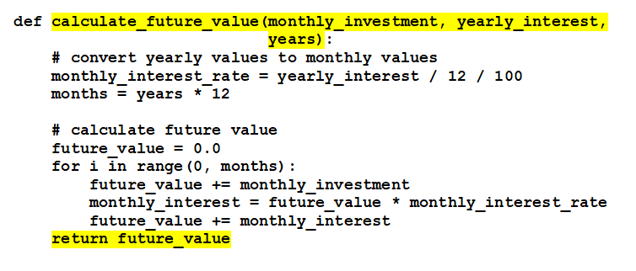
calculate_future_value example: The function code

Slide 8
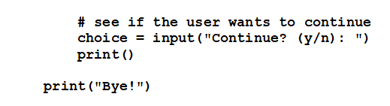
calculate_future_value example: The main (calling) code

Slide 9
A function with a default value
How to call the function and use its default value

Slide 10
How to call the function with named arguments
A function with a default value
Order of parameter arguments does not have to match if using named arguments.

Slide 11
What is a module?
A pre-defined Python file that contains reusable code like functions. Modules exist as .py files inside the standard Python library, and are available automatically to you as the programmer for use.
A complete list of Python modules along with the functions they provide can be found at https://docs.python.org/3/py-modindex.html.
To use a module in your code, use the import statement:
import temperature
To see help for a module, use the help statement:
help (temperature)

Slide 12
How to view the documentation for a module

Slide 13
The temperature.py file (temperature module)

Slide 14
The syntax for importing a module

Slide 15
The Convert Temperatures Program User Interface

Slide 16
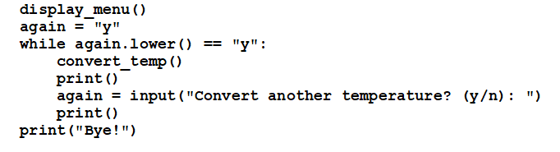
The code

